Slide 1
Chips and Dips
US, February 2016

Slide 2
The Issues
Chips and dips categories maintain growth
Millennials more likely to buy chips and dips
Taste, not health a key driver

Slide 3
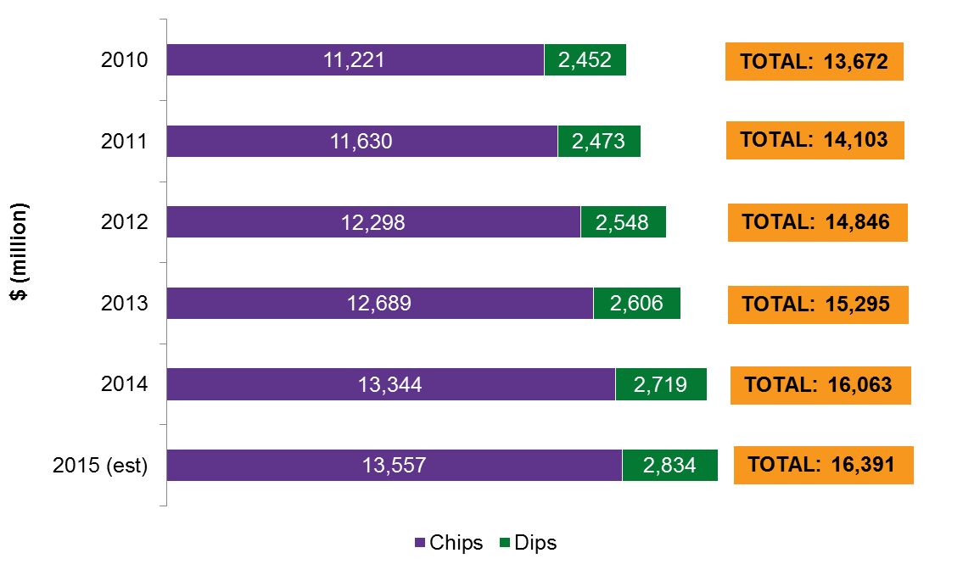
Chips and dips categories maintain growth
The combined chips and dips categories continue to perform well, growing 7% from 2013-15 to reach $16.4 billion in 2015. All four segments experienced a range of sales growth, but it is the potato chips segment that drives overall sales, representing half of the category market share. The second-smallest segment, dips, experienced the strongest growth over the last two years, fueled by strong innovation and consumer interest in global flavors. As consumers continue to snack, both categories are poised to collectively grow an additional 17% from 2015-20, reaching $19.2 billion in 2020.
TOTAL US SALES OF CHIPS AND DIPS AT CURRENT PRICES, 2010-15
Source: Based on Information Resources Inc., InfoScan Reviews; US Census Bureau, Economic Census/Mintel

Slide 4
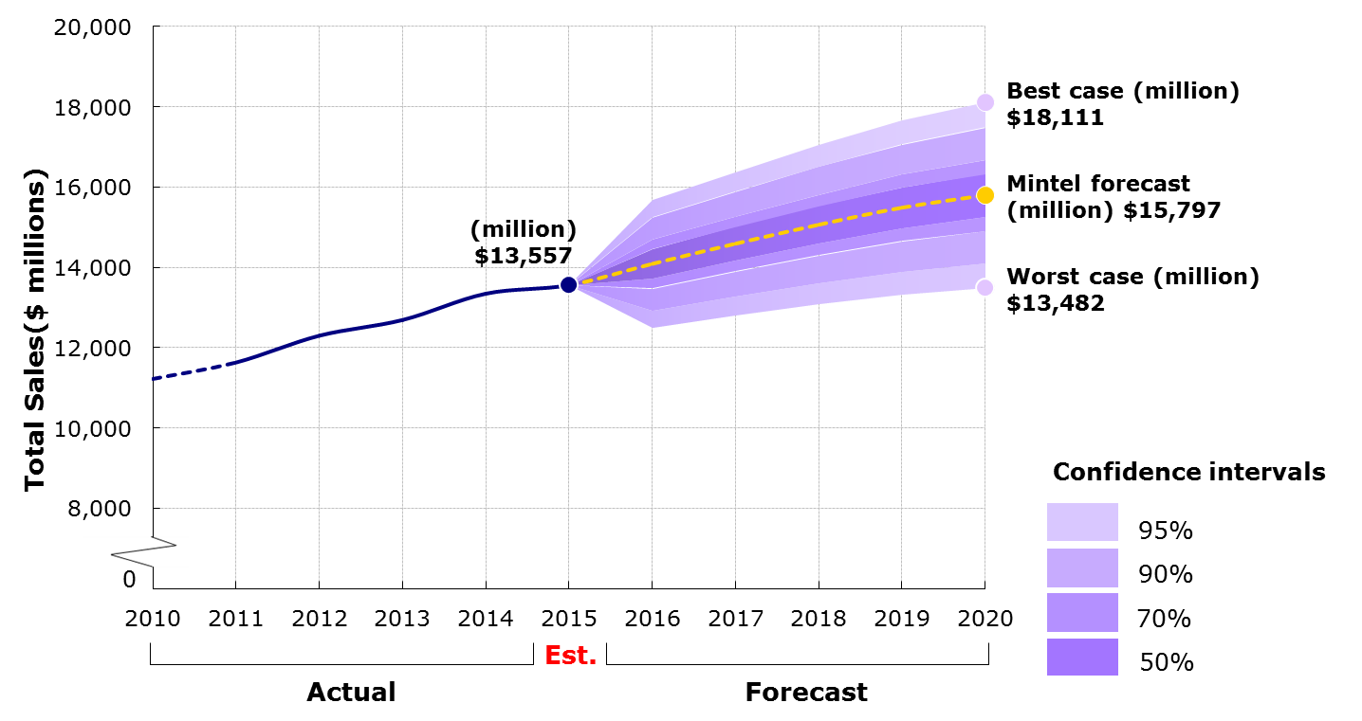
Chips and dips categories maintain growth
The chips category, comprised of potato chips and tortilla chips, has sustained strong growth over the last five years and is expected to maintain that growth over the next five years. Chip sales reached $13.6 billion in 2015, representing growth of 21% from 2010-15. The potato chip segment represents larger market share, however, growth of tortilla chips have been much stronger over the last five years. The chips category is forecast to grow an additional 17% from 2015-20 to reach $15.8 billion in 2020.
TOTAL US SALES AND FAN CHART FORECAST OF CHIPS AT CURRENT PRICES, 2010-20
Source: Based on Information Resources Inc., InfoScan Reviews; US Census Bureau, Economic Census/Mintel

Slide 5
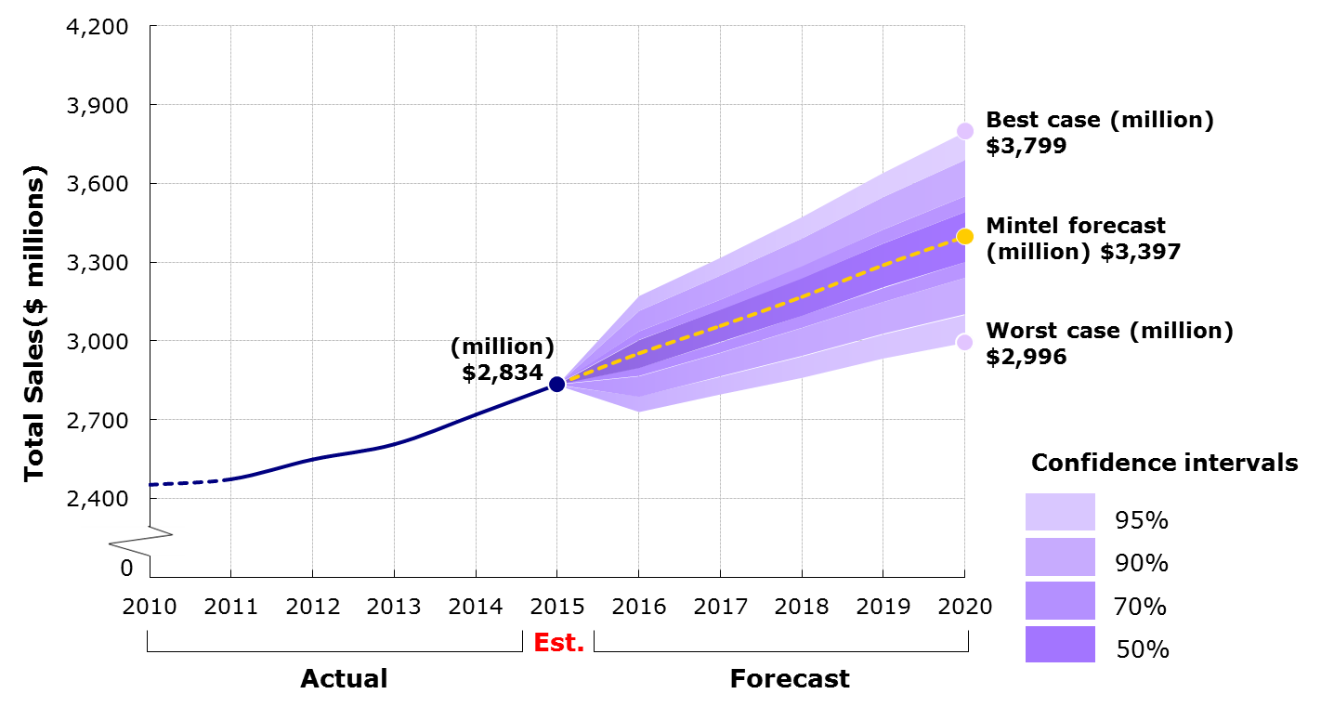
Chips and dips categories maintain growth
The dips category, which includes dips and salsa, reached sales of $2.8 billion in 2015, representing growth of 16% from 2010-15. The category is much smaller in comparison to chips, but had relatively stronger growth than both chips segments from 2013-15. While sales of dips and salsa are quite similar in 2015, the majority of growth in dips is driven by sales of dips, rather than salsa. Dip sales grew 26% from 2010-15 compared to salsa’s growth of 6% during this period. Mintel predicts the dips category to collectively grow an additional 20% from 2015-20, reaching $3.4 billion in 2020.
TOTAL US SALES AND FAN CHART FORECAST OF SALSA AND DIPS AT CURRENT PRICES, 2010-20
Source: Based on Information Resources Inc., InfoScan Reviews; US Census Bureau, Economic Census/Mintel

Slide 6
Millennials more likely to buy chips and dips
Chip and dip purchases tend to skew toward younger consumers, especially Millennials, or those aged 22-39. In general, Millennials are most likely to snack and are snacking more frequently this year compared to last, according to Mintel’s Snacking Motivations and Attitudes – US, April 2015 report. Millennial consumers also are more likely to purchase a variety of chips and dips, and likely to mix types together, helping to diversify their frequent snacking occasions. Furthermore, Millennials are buying more chips and dips this year, and buy them in bulk.
CHIPS AND DIPS PURCHASE – ANY PURCHASE, BY MILLENNIALS AND NON-MILLENNIALS, NOVEMBER 2015
"For which members of your household have you purchased each of the following products from a grocery store, not a restaurant, in the past six months?"
 | Any Purchase | Millennials | Non-Millennials
Base: internet users aged 18+ | 2,001 | 745 | 1,256
 | % | % | %
Any chips | 93 | 95 | 92
Any potato chips | 89 | 93 | 87
Regular plain potato chips | 79 | 83 | 77
Regular flavored potato chips (eg Mango Salsa, Jalapeno) | 65 | 80 | 56
Kettle-cooked potato chips (eg Mango Salsa, Jalapeno) | 59 | 70 | 53
Baked potato chips | 57 | 73 | 47
Popped potato chips (eg Pop Chips) | 36 | 57 | 23
Tortilla chips | 79 | 86 | 74
Any dips | 84 | 89 | 81
Salsa | 73 | 81 | 69
Refrigerated dips (eg spinach artichoke dip) | 53 | 64 | 47
Guacamole | 48 | 66 | 38
Hummus | 46 | 63 | 36
Non-refrigerated dips (eg cheese dip, French onion dip) | 44 | 63 | 32
Dry dip mixes (eg vegetable dip | 39 | 56 | 28
Source: Lightspeed GM/Mintel

Slide 7
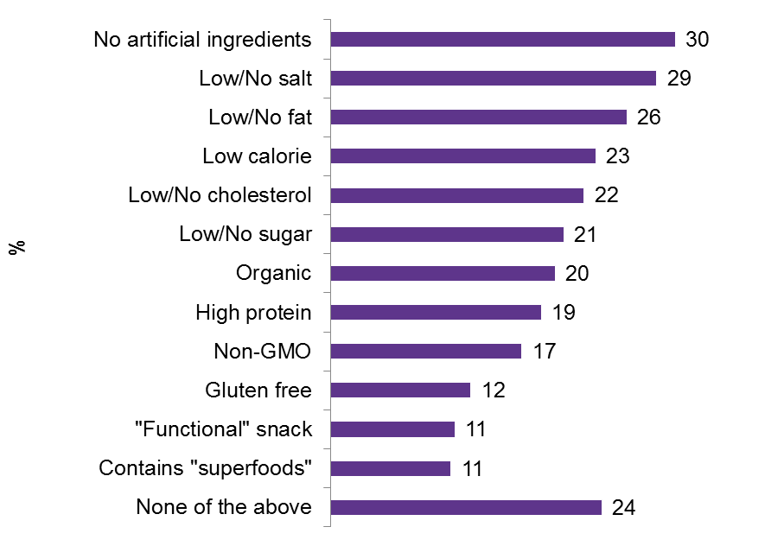
Taste, not health a key driver
When asked about the most important nutritional attributes when purchasing chips or dips, the highest rated attribute, no artificial ingredients, resonates with less than one third of consumers. Health-focused claims, such as low/no claims, organic, and high protein, are of less importance to consumers. Furthermore, 85% of consumers agree it’s okay to indulge from time to time, and slightly more than one third of purchasers eat chips and dips regardless of nutritional value. 24% of respondents reported none of the listed nutritional attributes were important to them.
IMPORTANT NUTRITIONAL ATTRIBUTES, NOVEMBER 2015
Base: 1,915 internet users aged 18+ who buy chips or dips
“Which of the following nutritional attributes, if any, are most important to you when purchasing chips or dips?”
Source: Lightspeed GMI/Mintel

Slide 8
The Opportunities
Promoted products across all retail channels
Appeal to Millennials’ adventurous palates
Focus on flavor innovation

Slide 9
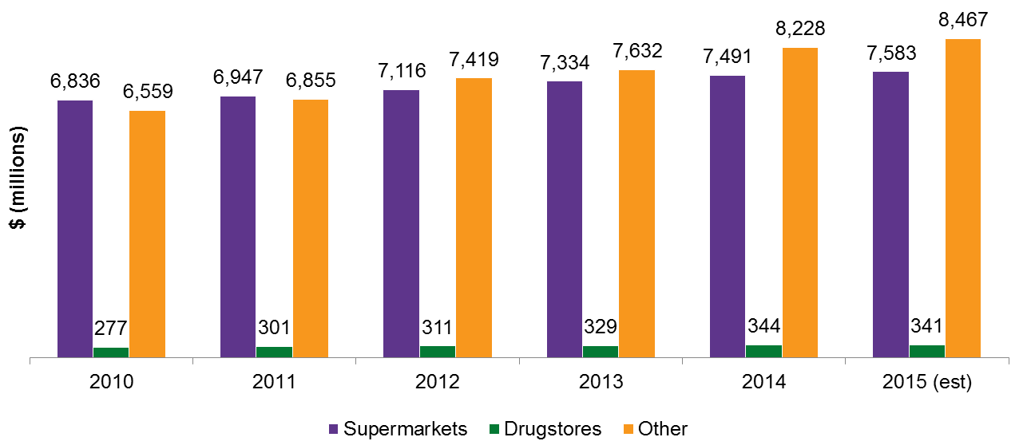
Promote products across all retail channels
Chips and dips sales mostly originate in other retail channels, which include supercenters, warehouse clubs, natural food stores, and other retailers. While most respondents to Mintel’s consumer survey report buying chips and dips at supermarkets, mass merchandisers are the second-most-common retailer, followed by warehouse clubs at a distant third. Growing consumer interest in online shopping, combined with greater convenience and product variety from online retailers, also is expected to continue eating away at supermarket sales. Drugstore sales account for a small share of the market, representing only 2% market share in 2015.
TOTAL US RETAIL SALES OF CHIPS AND DIPS, BY CHANNEL, AT CURRENT PRICES, 2010-15
Note: Other retail channels include supercenters, warehouse clubs, natural food stores, dollar stores, off-price retailers, non-store retailers, etc.
Source: Based on Information Resources Inc., InfoScan Reviews; US Census Bureau, Economic Census/Mintel

Slide 10
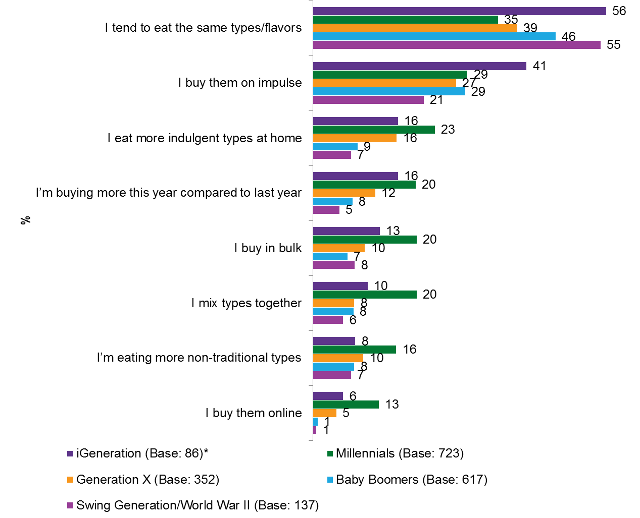
Appeal to Millennials’ adventurous palates
Millennials are more adventurous when eating chips and dips, compared to older generations. They are least likely to eat the same types or flavors of these products, and most likely to eat products with non-traditional bases, such as Greek yogurt dips, or quinoa chips. Brands with innovative flavors or bases are likely to appeal to this generation. Because Millennials are most likely to mix products together, brands that encourage mixing of chips and dips, or variety packs may appeal to them.
CHIPS AND DIPS BEHAVIORS, BY GENERATION, SELECT STATEMENTS, NOVEMBER 2015
Base: internet users aged 18+ who buy chips or dips
“Which, if any, of the following statements about chips and dips do you agree with?”
Source: Lightspeed GMI/Mintel

Slide 11
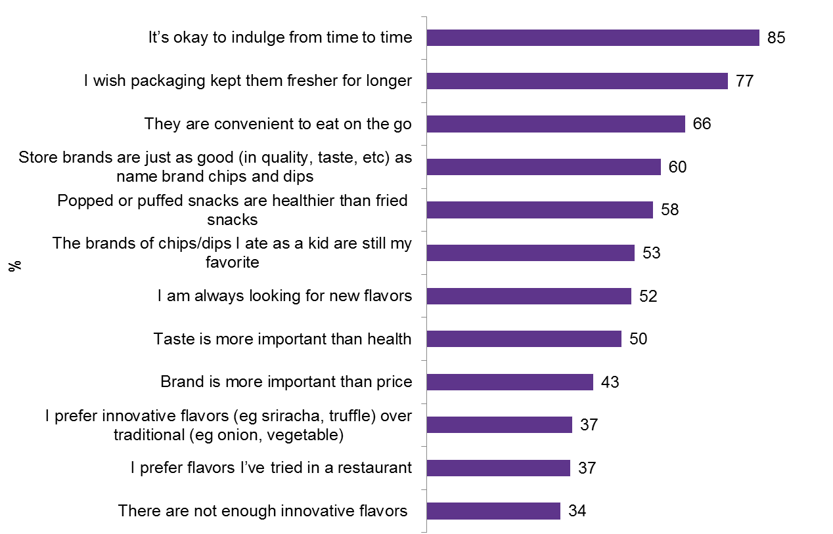
Focus on flavor innovation
As indulgence remains a key theme in the chip and dips categories, and consumers place importance on product flavors and taste, there is room for increased flavor innovation. Areas of innovation include expanded global and restaurant-quality flavors, as well as less traditional options which Millennials and Hispanics are interested in, especially as they are more likely to look for new flavors. Furthermore, consumers indicate a new flavor is the top factor that would increase their purchase of chips or dips.
ATTITUDES TOWARD CHIPS AND DIPS – ANY AGREE, NOVEMBER 2015
Base: 1,915 internet users aged 18+ who buy chips or dips
"Please indicate how much you agree or disagree with each of the following statements about chips and dips."
Source: Lightspeed GMI/Mintel

Slide 12
What it Means
As consumers continue to snack frequently, the chips and dips categories will continue to benefit. While many food categories are marked by consumer interest in health and better-for-you products, the chips and dips categories thrive off a desire to indulge. Innovative flavors and formats catered to core snackers, especially Millennials, can help propel these markets forward, while older consumers represent a unique subset interested in healthy chips and dips.

Slide 13

Amanda Topper
Senior Food Analyst
info@mintel.com
mintel.com

